Slide 1
Monte Carlo / Metropolis for the Potts model
Mario Könz / Dominik Gresch

Slide 2
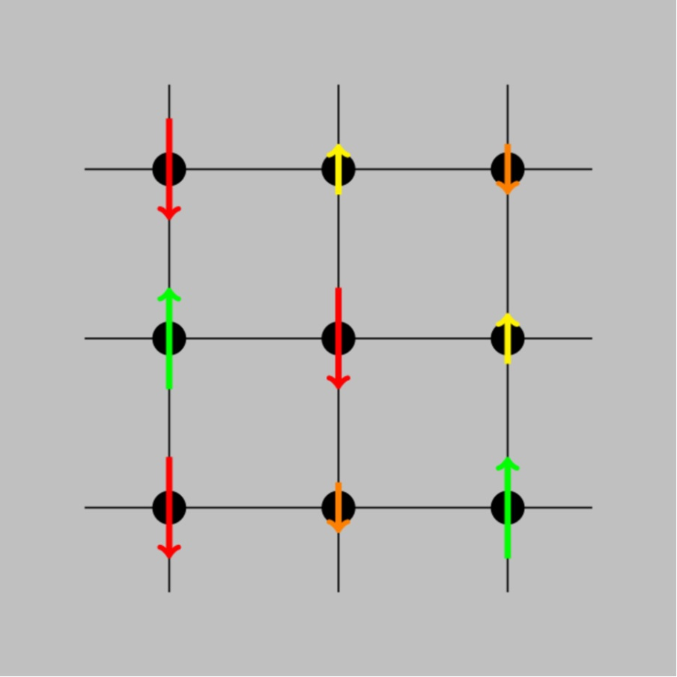
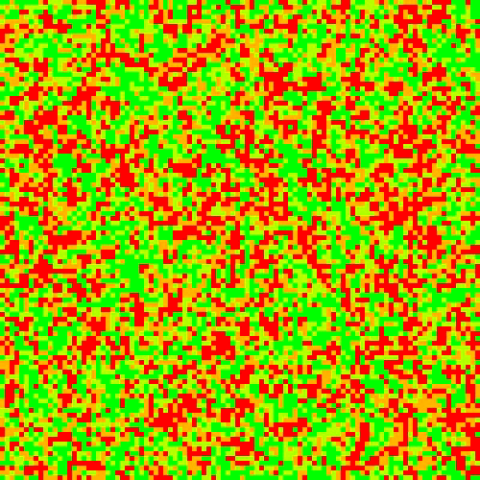
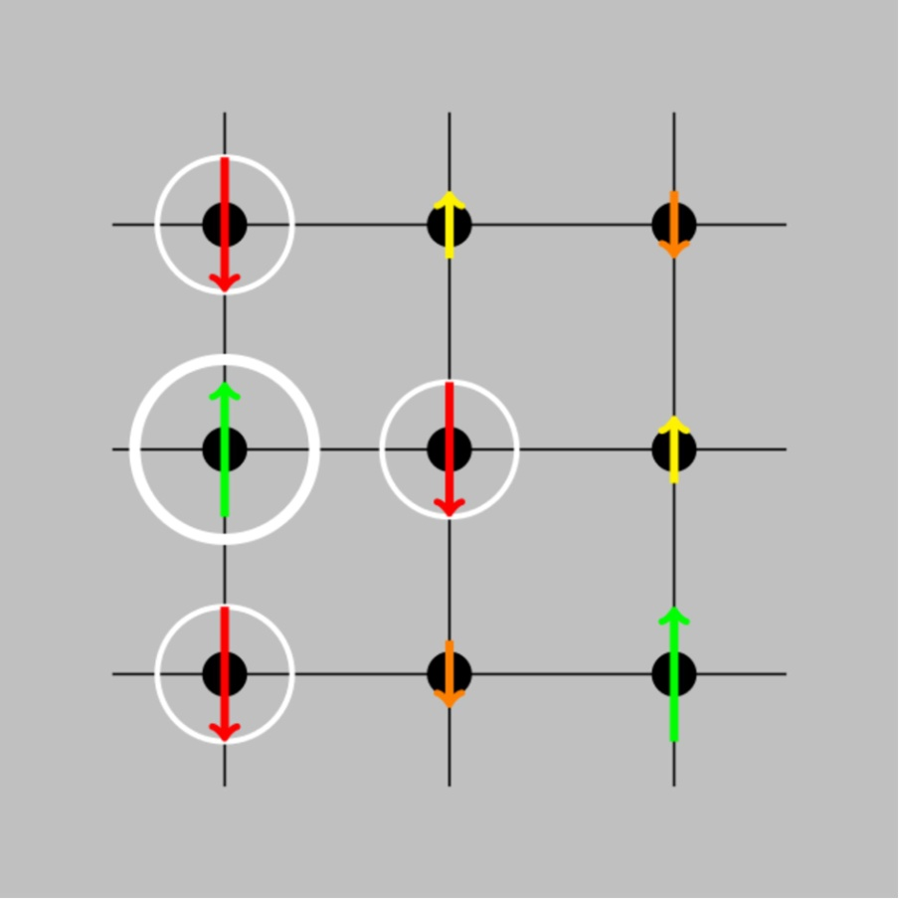
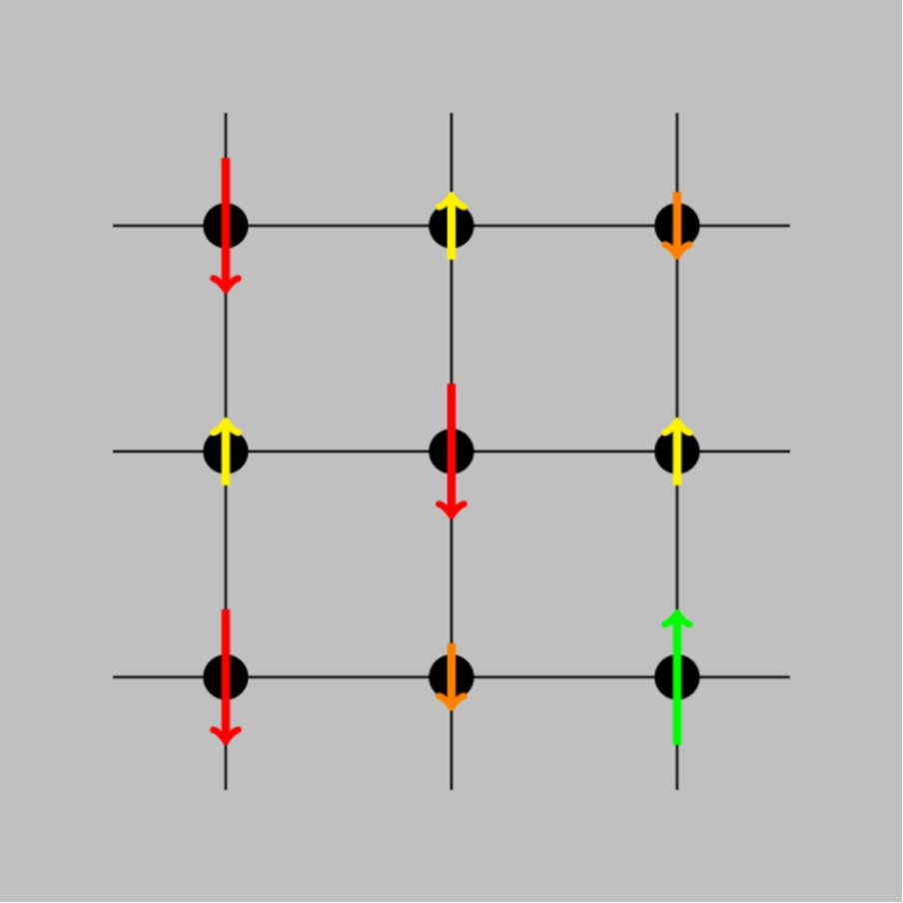
Physical Problem
3D Potts Model (4 states)

Slide 3
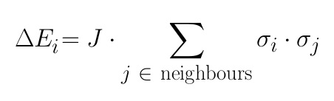
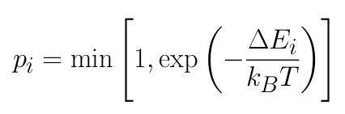
Metropolis algorithm
Steps
Computation
select random spin
select random direction of change
calculate energy difference
accept change with probability
RNG
RNG
memory access, periodic boundary
RNG, exponential

Slide 4
Modules
SIM
metropolis algorithm
measurement
contains GRID & RNG
GRID
boundary condition
contains MATRIX
MATRIX
storage format of spins
handles data type and ordering
RNG
MT19937

Slide 5
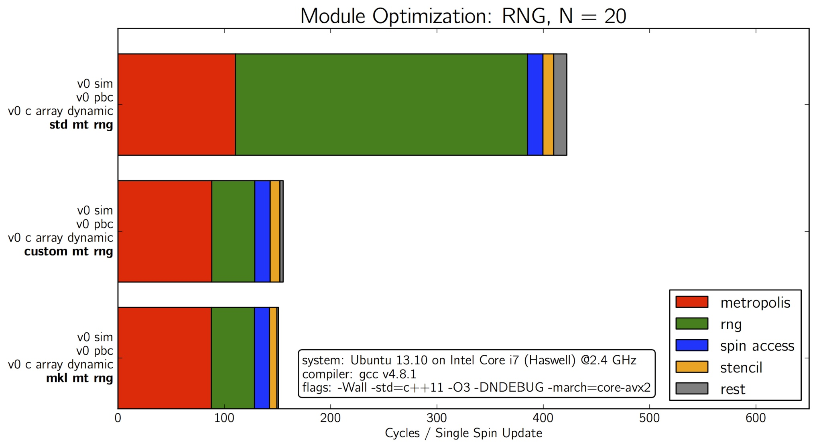
economic RNG usage / MKL

Slide 6
boundary condition lookup table

Slide 7
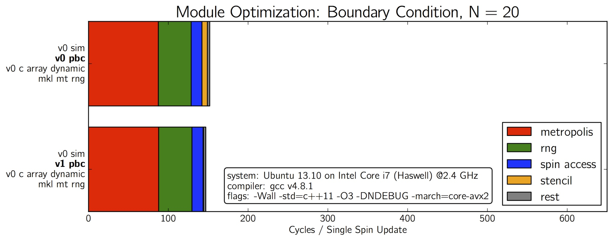
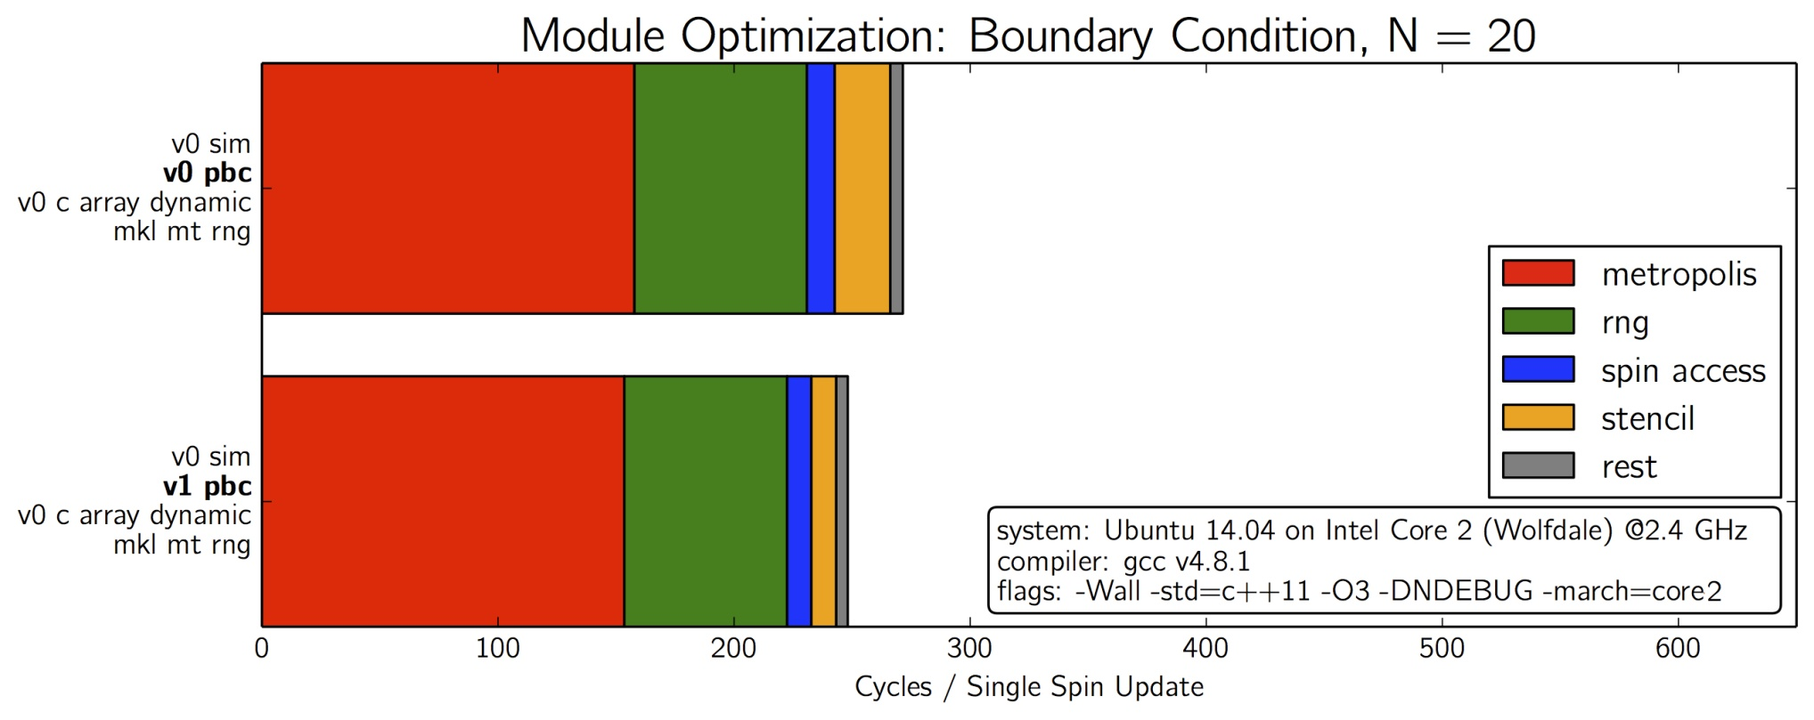

Slide 8
precompute exponentials

Slide 9
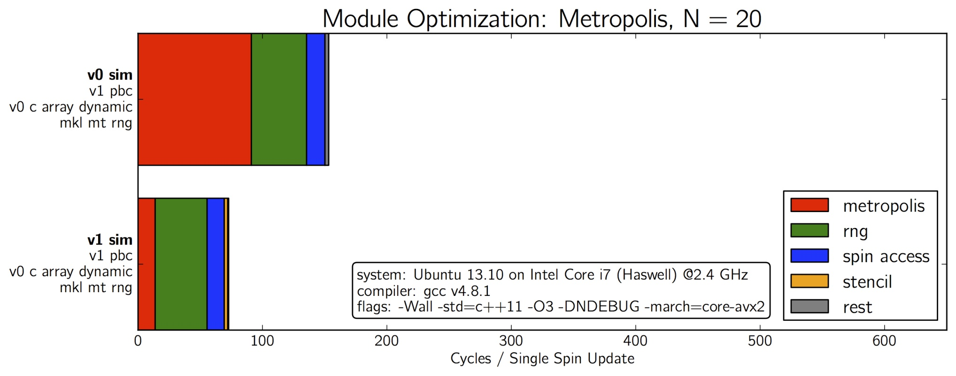
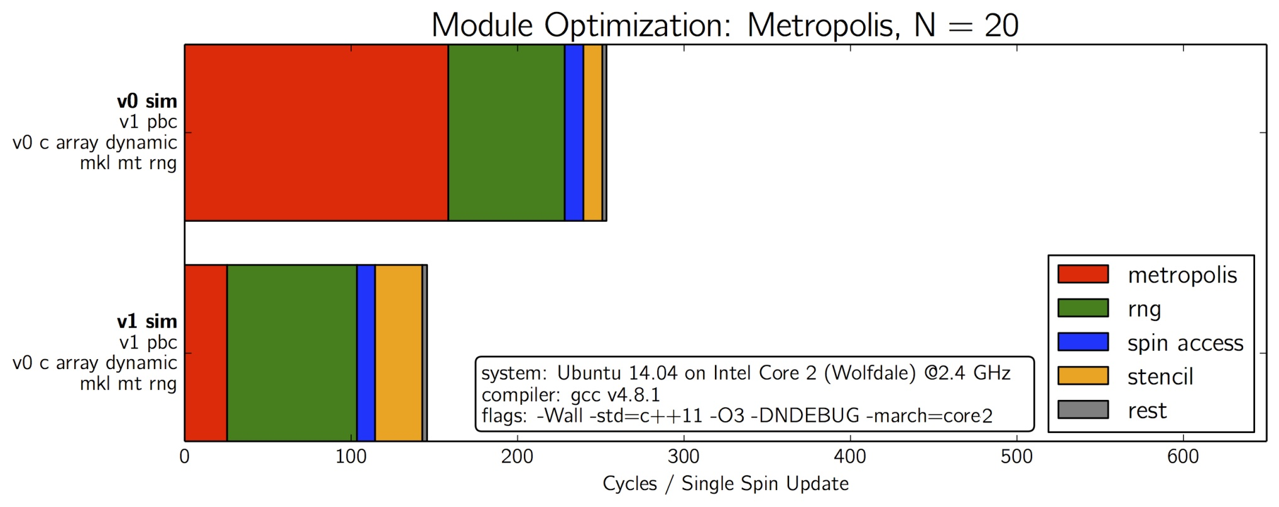

Slide 10
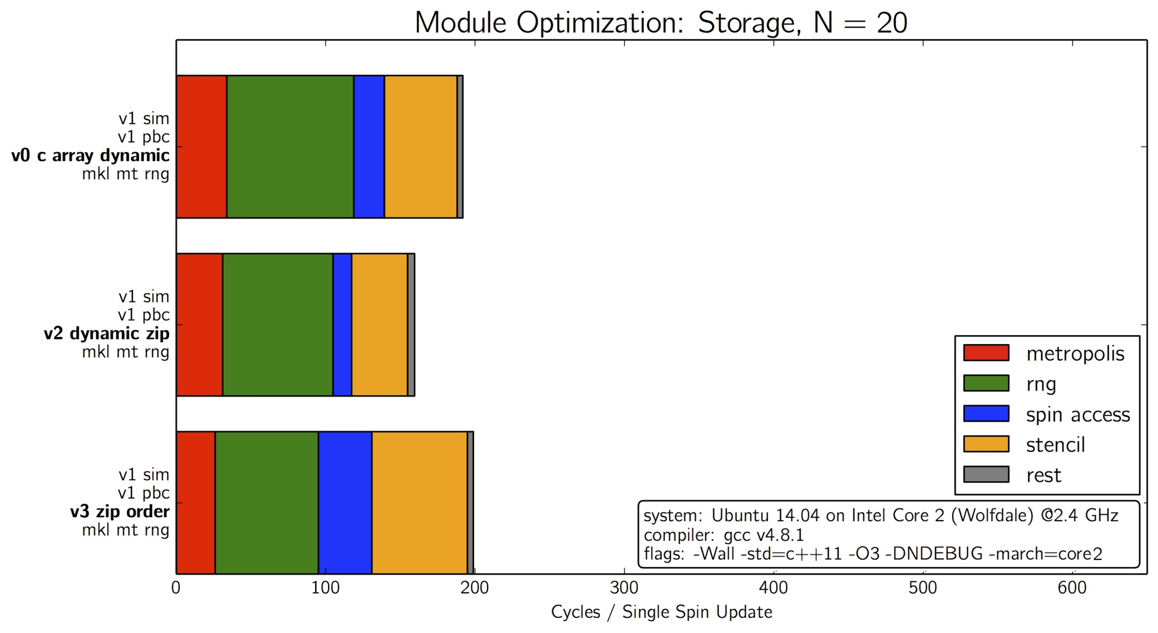
compression / Z-order

Slide 11
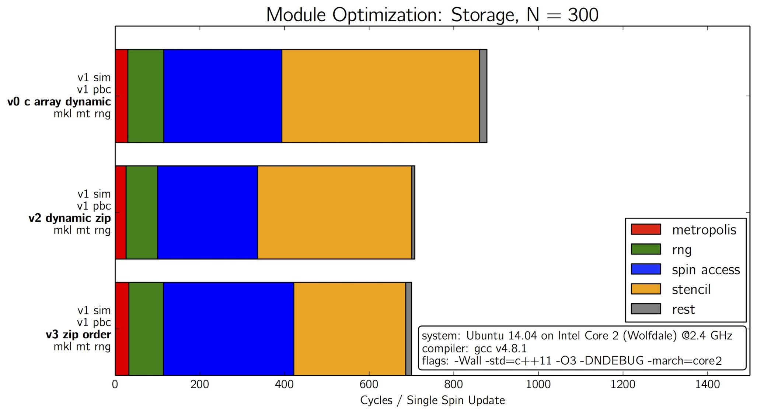
compression / Z-order

Slide 12
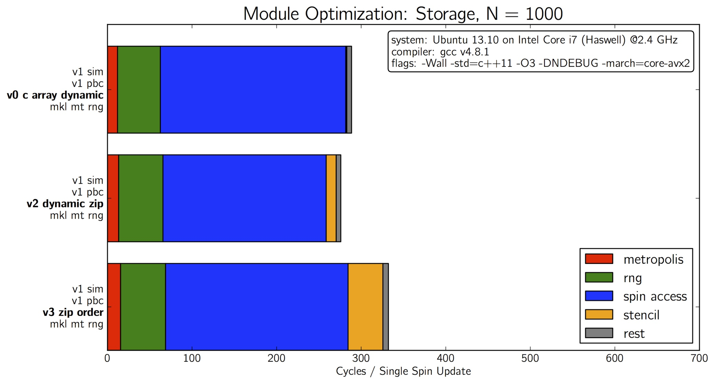
Haswell prefetching?

Slide 13
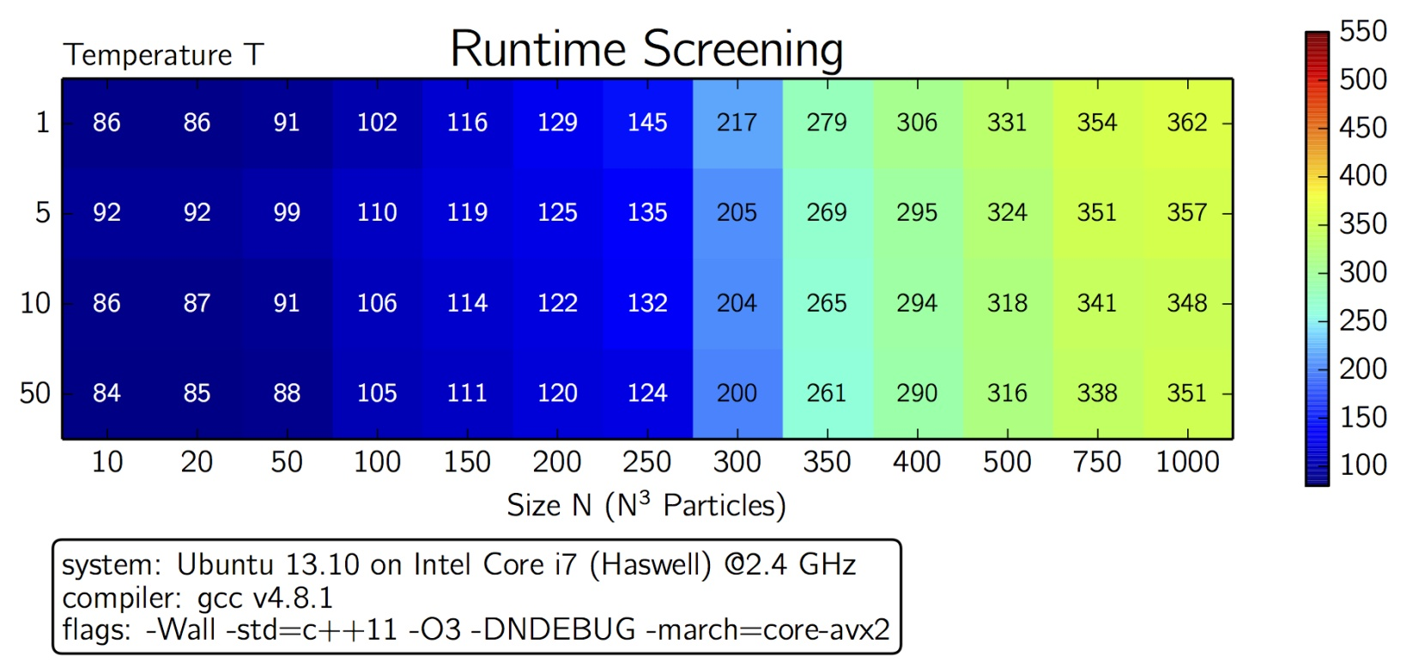
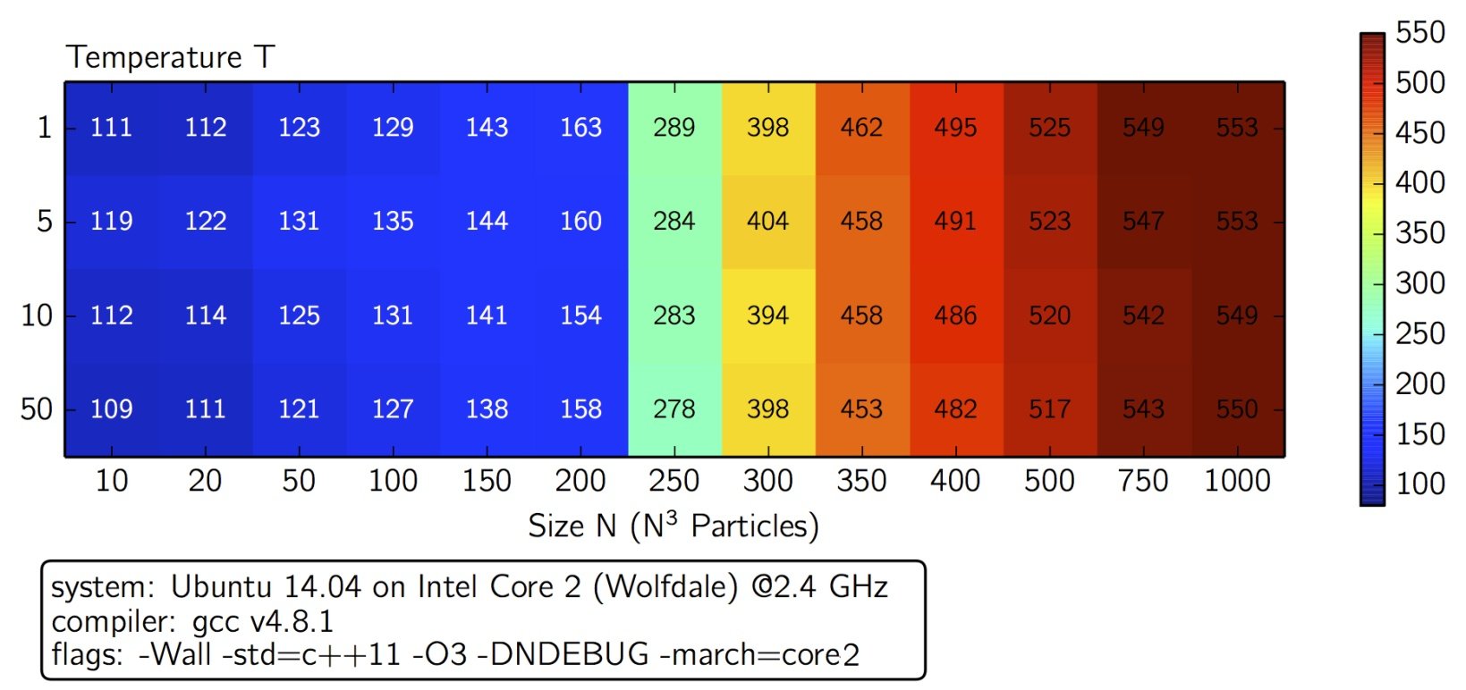

Slide 14
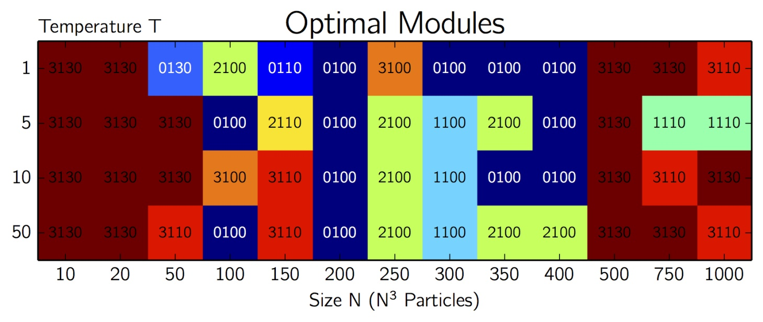
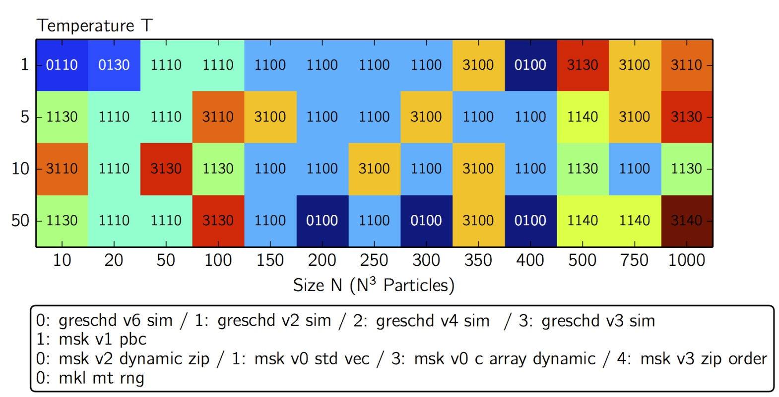
Haswell
Wolfdale

Slide 15
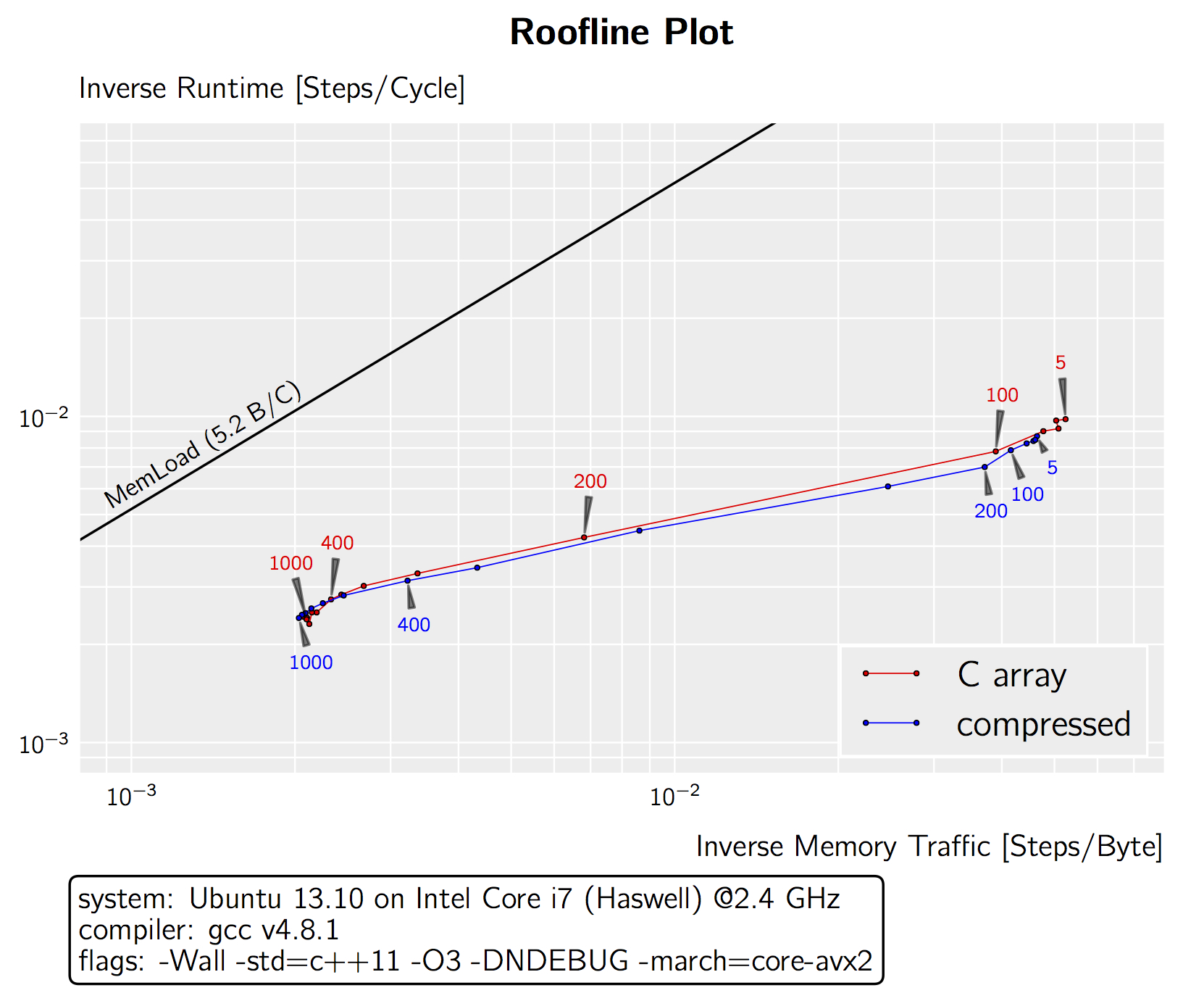
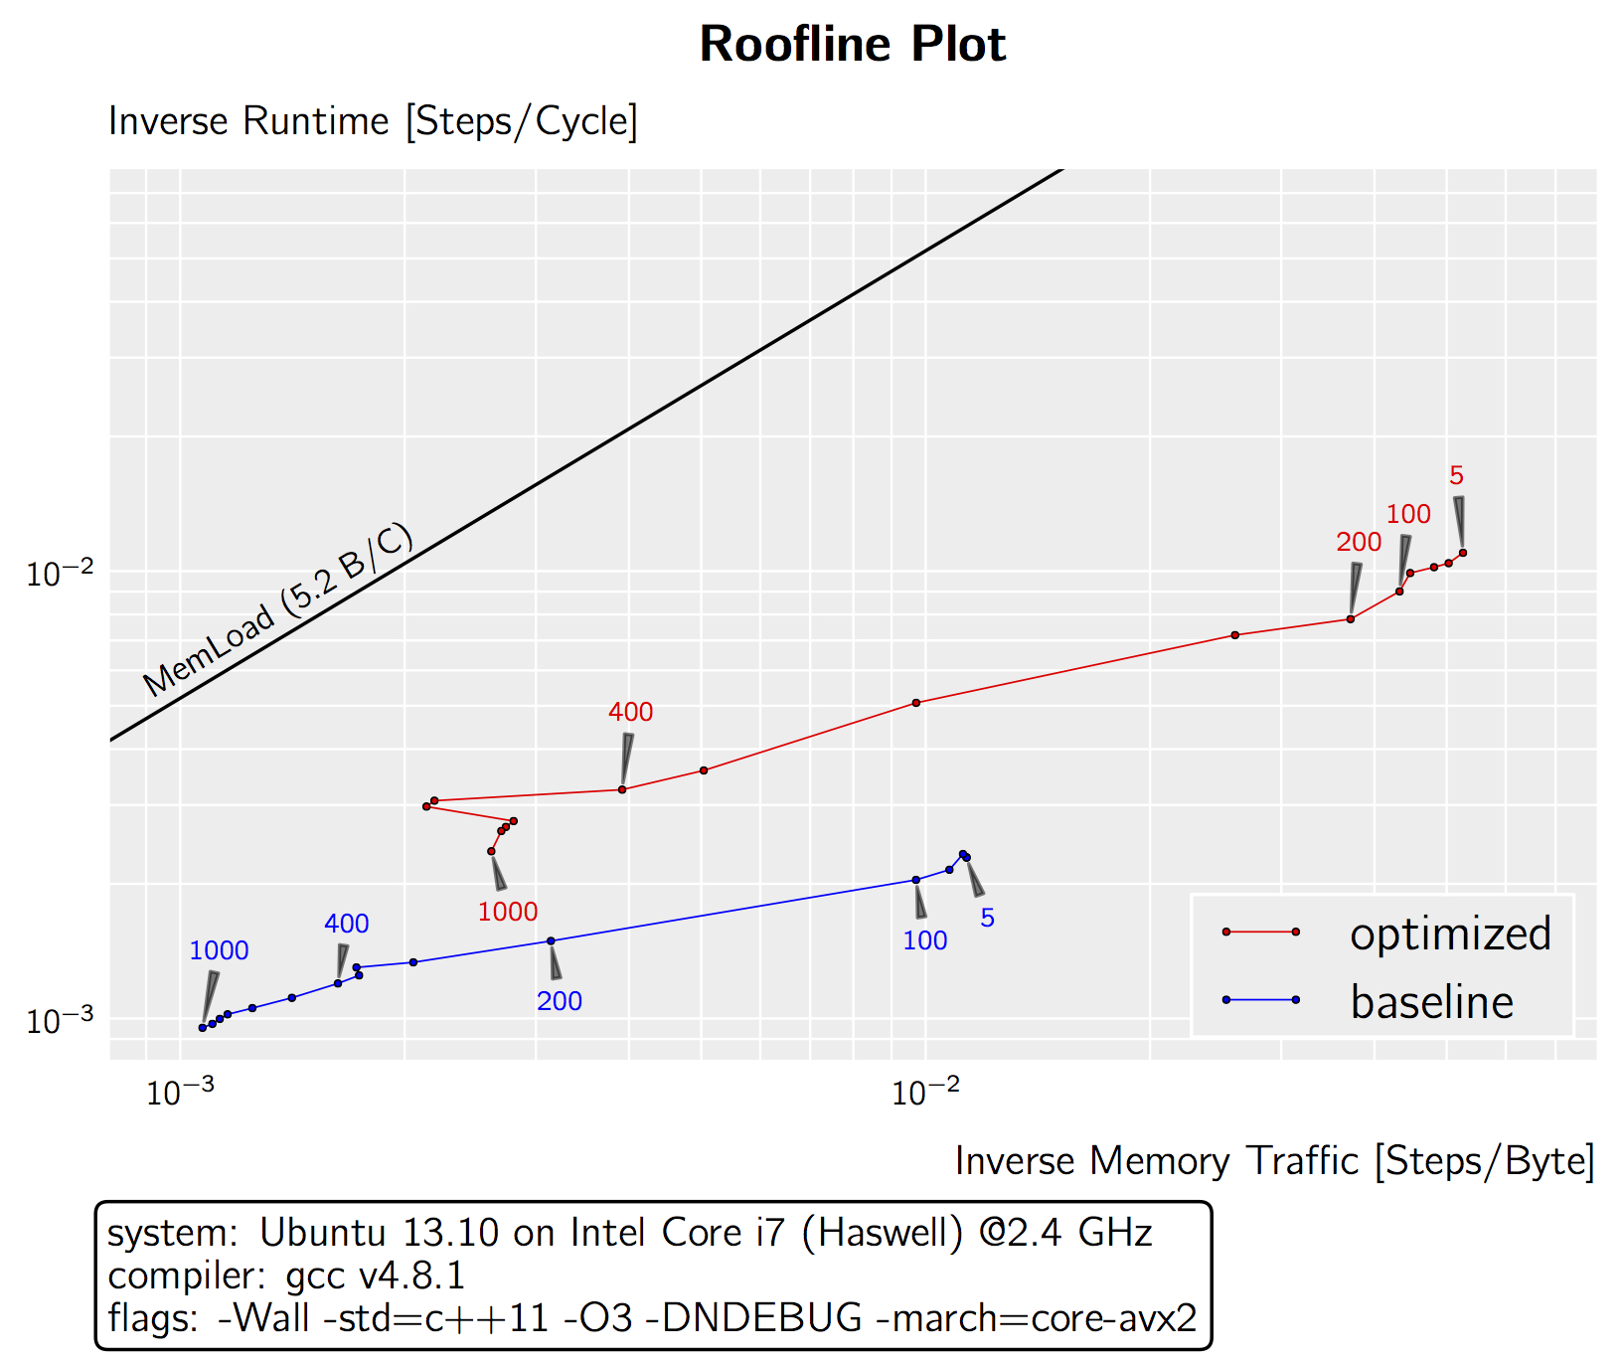

Slide 16
Thank you for your Attention
Questions?

